Slide 1
British Airways Review Analysis Task 1

Slide 2
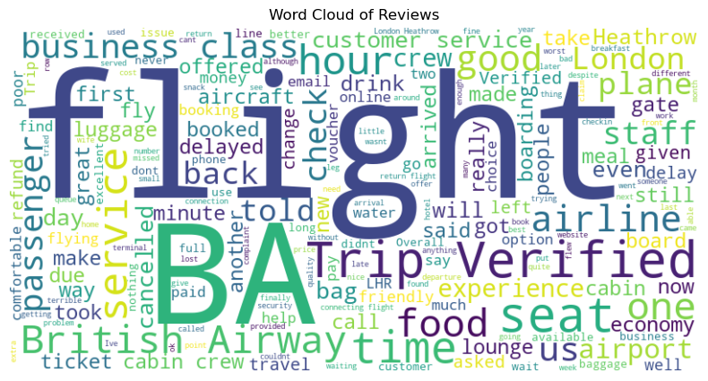
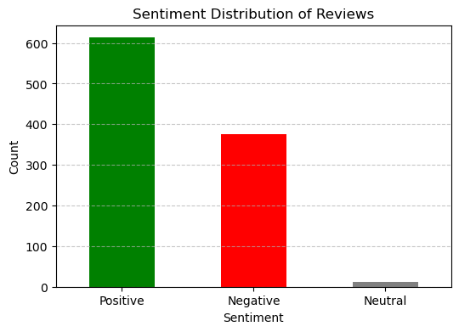
🔹 Sentiment Analysis:
- ✅ Positive: 61.3%
- ❌ Negative: 37.5%
- ⚖ Neutral: 1.2%
🔹 Top Topics from Reviews:
1️⃣ In-flight Experience – Crew, service, food.
2️⃣ Boarding & Staff – Gate, cabin, boarding process.
3️⃣ Customer Service Issues – Refunds, complaints.
4️⃣ Baggage & Airport Issues – Luggage delays.
5️⃣ Flight Reliability – Cancellations, delays.
🔹 Key Recommendations:
✅ Improve customer service responsiveness.
✅ Reduce cancellations & baggage delays.
✅ Enhance in-flight experience (food, seats, service).

